Slide 1
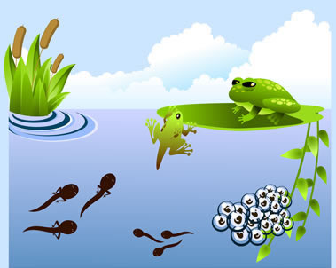

The Life cycle of a frog
By
Shannon Barbera

Slide 2
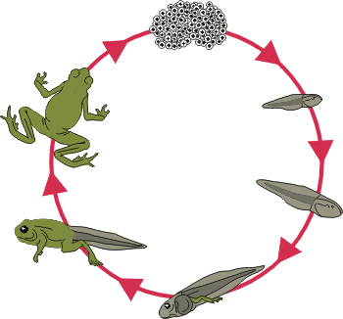
The Life Cycle of a Frog
We are going to talk about the life cycle of a frog today.
In the picture you can see the different stages of how a tadpole becomes a frog.
Look at the picture, do you see how from baby to adult looks like a circle?

Slide 3
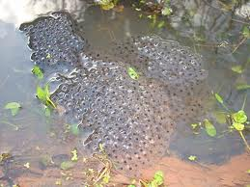
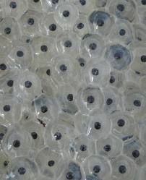
Frog Spawn
Frogs lay their eggs in wet places or in water. The eggs do not have shells.
The eggs clump together and float, this is called frog spawn.
The eggs clumped together are slippery and too big to be eaten. This is natures way of protecting the frog spawn.
It only takes a few days for the eggs to hatch.

Slide 4
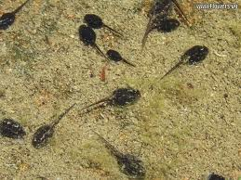
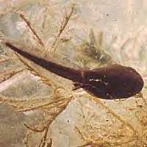
Tadpoles
Tadpoles have a head, tail and body. They live under water and breathe through their gills. They eat algae and other tiny water plants as they swim. After about a month, a bulge appears at the base of their tail where their hind legs will grow. They also begin to grow lungs for breathing.

Slide 5
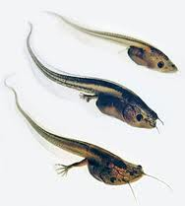
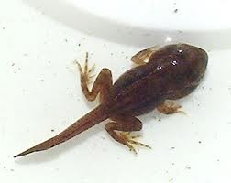
Tadpoles to Froglets
After seven weeks their hind legs begin to grow.
After nine weeks, front legs grow and their tails are almost gone.
After about twelve weeks the tadpoles can swim to the surface of the water and breathe in air.

Slide 6
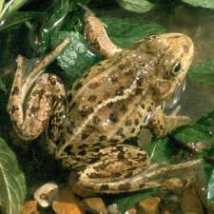
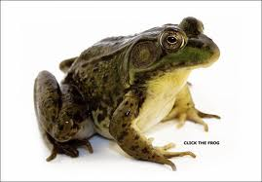
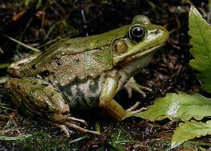
Adult Frog
Eleven weeks after the egg was laid, a fully developed adult frog with lungs, legs, and no tail emerges from the water.
This frog will live mostly on land, with occasional swims. The tiny frogs begin to eat insects and worms.
Eventually, it will find a mate. The female lays the eggs, the male fertilizes them, and the whole process begins again.

Slide 7
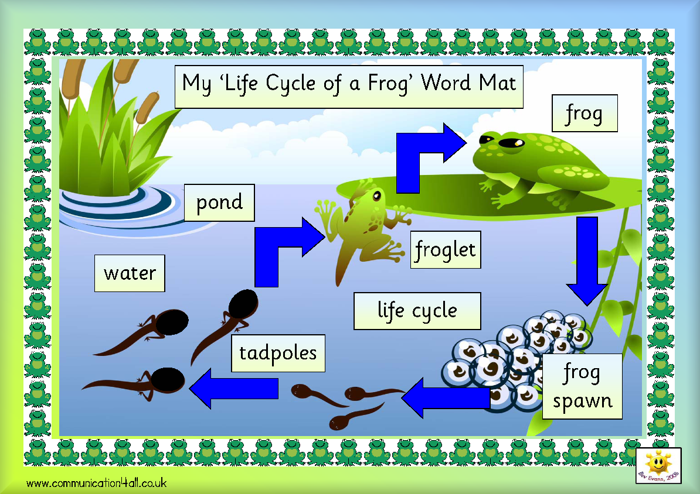
Life Cycle of a Frog
http://www.teachertube.com/viewVideo.php?video_id=169622&title=Frog_Life_Cycle

